Slide 1
What Does NCI’s Cancer Data Science Laboratory Do?
and
(by the way) What Is Cancer Data Science?
Alejandro A. Schäffer
Staff Scientist
Formerly: NCBI, NLM, NIH
Now: CDSL, CCR, NCI, NIH

Slide 2
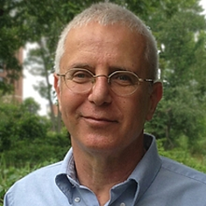
Collaborators for Two NCBI Projects:
For vecscreen_plus_taxonomy: Rich McVeigh, Eric P. Nawrocki, Ilene Karsch-Mizrachi, Yoon Choi, Paul Kitts (NCBI)
For GRAF: Yumi Jin, Michael Feolo (NCBI)
Current Members of CDSL:
Eytan Ruppin (Lab Chief), Nadia Nimley (Program Specialist), Lesley Chapman, David Crawford, E. Michael Gertz, Joo Sang Lee, Nishanth Ulhas Nair, Sushant Patkar, Welles Robinson, Alejandro Schäffer, Sanju Sinha, Philippe Youkharibache and growing
Alumna of CDSL
Noam Auslander (to be Post-Doc at NCBI/NLM)

Slide 3
Acknowledgments
John Tukey (1962) Foundations of Data Analysis
David Donoho (2015) 50 Years of Data Science
Training at Bell Labs in summer 1984, summer 1985, Post-Doc 1988-89 that gave me some insight into why would John M. Chambers and Rick Becker would be developing S (corporate version of R) at Bell Labs and not in academia?
Noam Auslander and Joo Sang Lee for CDSL slides
Academic Salary Data:
https://www.ams.org/profession/data/annual-survey/2016Survey-FacultySalaries-Report.pdf
https://www.amstat.org/asa/files/pdfs/YCR-2017-2018-AcademicSalaryReport.pdf
https://cra.org/wp-content/uploads/2018/05/2017-Taulbee-Survey-Report.pdf

Slide 4
Basic Problems in Cancer Amenable to Data Science
Does a patient have cancer?
What is a cancer patient’s prognosis based on biomarkers?
Will a patient respond to some treatment, e.g., immunotherapy?
Will a combination of treatments be synergistic or toxic?
The availability of massive genomic and image data sets with clinical annotation makes possible head-to-head comparisons of predictors that are encoded in usually open software and run reproducibly.

Slide 5
Excerpts from NCI’s ad for CDSL chief
“at the forefront of data science in fields such as, but not limited to, integrative genomics, network approaches to biology, computational modeling, and mathematical oncology”
“build a new multi-PI research program” (recruiting ongoing)
“oversee a computational Collaboratory consisting of multiple computational scientists with the goal of enabling high-end computational analysis projects for the entire CCR community”
CDSL is temporarily housed on NIH’s Bethesda campus, Bldg. 10, CRC, 1st floor, east wing.

Slide 6
Key Aspects of Data Science
Inherently multidisciplinary (at least Stat, CS, Subject area (for this audience, biology))
Data exploration and hypothesis generation
Data modeling, machine learning, algorithms
Making testable predictions
Data visualization, explanation of findings to subject experts
Software development (R, python) and database management
Data quality control (avoid garbage in, garbage out)

Slide 7
What is Controversial About Data Science?
Academic turf wars between departments of Statistics, Biostatistics, Computer Science are in different Schools – leading to very different salary scales (see Table below)
Unlike Bell Labs in the 1980’s where Computer Science, Mathematics, Statistics groups sat near each other and collaborated daily.
Donoho’s “snarky definition of a data scientist”: Data Scientist (n.): Person who is better at statistics than any software engineer and better at software engineering than any statistician.
2) Tension between open, reproducible science and human subjects protections – real danger at NIH
Field | Assistant P. | Associate P. | Full P.
Stat. (AMS) | $90,600 | $106,400 | $142,300
Stat. (ASA) | $92,004 | $102,142 | $148,368
Biostat. (AMS) | $108,800 | $138,600 | $204,400
Biostat. (ASA) | $110,000 | $143,091 | $198,435
Comp. Sci. (CRA, private) | $112,525 | $128,015 | $184,034

Slide 9
Checkpoint blockade therapy
Only a subset of patients respond to immune checkpoint blockade (ICB)
Adverse effects may occur through immunologic activation
Predicting patients that are most likely to benefit from treatment is of crucial value.
Such accurate predictors are still lacking, likely due to the complexity of the immune response and lack of sufficient data
Approach: build immune state predictors using other, non-ICB response clinical data (“transfer learning”).
N. Auslander

Slide 10
Metastatic melanoma spontaneous regression
13.8-50% of primary melanomas are found to have clinically and histologically identifiable regression (3.7 to 15% for complete spontaneous regression).
Melanoma is accounted for 11% of the cases of spontaneous regression of metastases exceeded only by hypernephroma and neuroblastoma
Melanoma spontaneous regression is believed to be a result of activated immune response
Evidence of metastatic melanoma patients achieving spontaneous regression after infections, fevers and vaccinations
Unfortunately – No available data

Slide 11
Neuroblastoma (NB) spontaneous regression
Neuroblasoma is highly heterogeneous in clinical response
Infants (<18 months) often undergo spontaneous regression.
Biomarkers are routinely used in the clinic (MYCN and ALK)
A mechanism possibly accounting for spontaneous regression is cellular immunity, based on the presence of tumor-infiltrating lymphocytes, tumor-targeted T-cells and anti-neural antibodies in NB
Large cohort of NB spontaneous regression data is publicly available

Slide 12
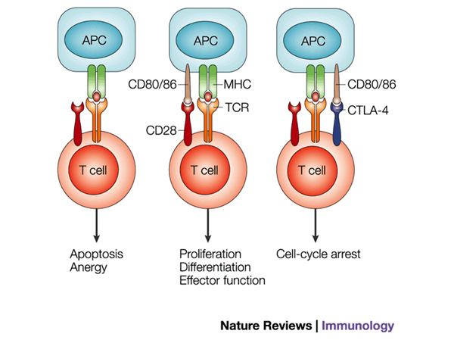
IMmuno-PREdictive Score (IMPRES)
Binary pairwise relations between the expression levels of immune checkpoint genes.

Slide 13
IMmuno-PREdictive Score (IMPRES)
15 most predictive pairs inferred using only NB spontaneous regression data
IMPRES scores vary between 0-15, with higher scores predicting spontaneous regression

Slide 14
IMPRES captures immune activity associated with prognosis of melanoma patients
IMPRES scores are significantly higher in melanoma patients denoted as ‘high immune response’ vs. other subtypes
IMPRES scores are significantly and positively associated with overall increased survival

Slide 15
Applying IMPRES to predict ICB response of patients with advanced melanoma
Performance of IMPRES predictor on melanoma with no further training
258 publicly available samples
(9 datasets from 6 studies)
41 sample, unpublished data

Slide 16
Applying IMPRES to predict ICB response of patients with advanced melanoma
Performance of IMPRES predictor on melanoma with no further training
258 publicly available samples
(9 datasets from 6 studies)
41 sample, unpublished data

Slide 17
Comparing IMPRES to other predictors
Notes:
GZMA,PRF1

Slide 18
Comparing IMPRES to other predictors
Notes:
GZMA,PRF1

Slide 19
Comparing IMPRES to other predictors
Notes:
GZMA,PRF1

Slide 20
Take-home messages from IMPRES
Key immune mechanisms underlying cancer spontaneous regression can predict response to ICB therapy.
Specific pairwise relations of immune checkpoint genes’ expression are predictive of cancer spontaneous regression and ICB response.
Building on these assumptions indeed leads to a robust predictor of response to checkpoint therapy that is markedly superior to the state of the art.

Slide 21


Slide 22
Our approach to identifying new cancer treatment strategies is based on harnessing two types of genetic interactions:
We use synthetic lethal interactions to identify cancer specific vulnerabilities and guide precision therapy
We harness synthetic rescue interactions to combat resistance to therapy;
Notably, such efforts have only become possible very recently thanks to the ongoing “big data” cancer projects

Slide 23
Synthetic Lethality is by far the most familiar form of genetic interactions
Definition: Two genes are Synthetic Lethal (SL) if the single inhibition of either genes is viable but the inhibition of both genes together is lethal.
A
B
Cell survival
A
B
Cell survival
A
B
Cell survival
A
B
Cell death/
Synthetic lethality
Notes:
We don’t think that this is on instance, but it’s a general phenomenon where perturbation of one gene like ERBB2 is lethal and it can be rescued by over-activation of other genes. In this fig, we are showing activity state of Gene A (low activation … ). Even in yeast, such phenomeon appears commonly where knowout of gene is lethal, but knockout of same gene along with knockout of other gene is viable. We set out to identify such interaction in genomewide faishon. Note here that SR intereaction of one kind, essentially rescue can happen with over or under expression and so is lethality. Therefore there are 4 kind of SR interactions.

Slide 24

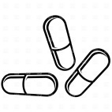


Our network-based approach
A bird’s eye view of the general scheme of things…
Large-scale patient data
Synthetic lethal network
Precision-based treatment
Responders
TCGA >14k patients
Rapidly being accumulated
Non-responders
Structure of the talk
1. Network Identification
2. Network Validation
3. Outcome Prediction
Hartwell et al. Nature (1997); Jerby et al. Cell (2014);
Notes:
My talk is composed of 3 parts:
SL network identification from TCGA data
Network validation using in vitro/in vivo data
Applying the network to predict drug response in patients.

Slide 25
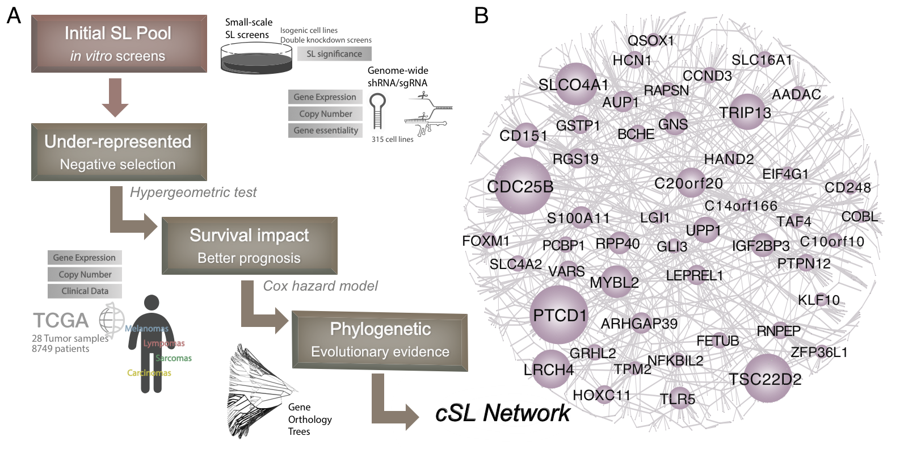
Identifying clinically relevant (cSL) interactions via ISLE
J. S. Lee
Notes:
We came up with a new SL inference pipeline termed ISLE. It is composed of 4 statistical screenings:
We first search for gene pairs via large scale shRNA screening data , where one gene leads the cancer cells to dependent on another gene.
We then analyze TCGA omics and survival data and search for the candidate pairs that satisfy the following two conditions:
First, we search for pairs that are lost together significantly less than expected, testifying that their co-loss is selected against and they may be synthetic lethal.
Second, we search for the gene pairs whose co-inactivation is associated with better prognosis, testifying to their functional significance.
1. It would be more likely to work in clinic (needs to be validated)
2. It is more general, we are searching for SL pairs that are more general across multiple cancer types and cell lines.
We additionally filter the pairs based on their similarity in phylogenetic profiles.
The resulting genome-wide SL network is composed of 2200 interactions between 2000 genes, and enriched with cell adhesion and cell cycle regulation processes, which are important for cell proliferation and migration.

Slide 26
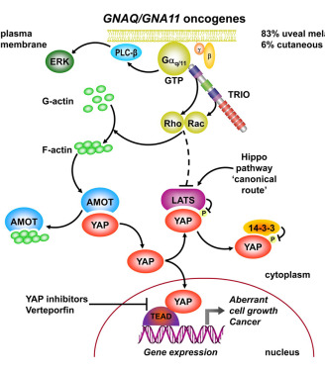
Somatic mutations in oncogene GNAQ/GNA11, which encodes the protein called Gq (or Gαq), activate YAP in uveal melanoma (UM)
The mutant Gq protein stimulates the transcriptional coactivator YAP
YAP is essential for Gq-induced uveal melanoma cell proliferation
However, the existing YAP inhibitor (verteporfin) provides only an anecdotal clinical success and induces serious side effects.
Currently there exists no effective therapeutic targets for UM.
Feng et al. Cancer Cell (2014)

Slide 27
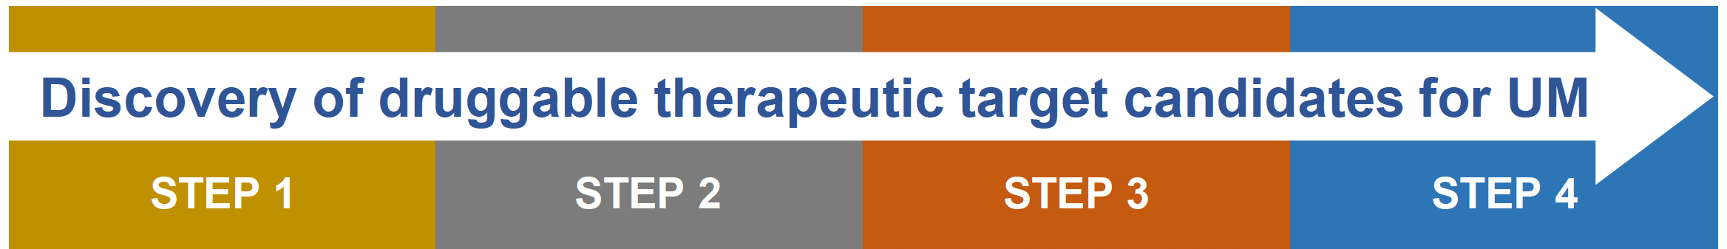
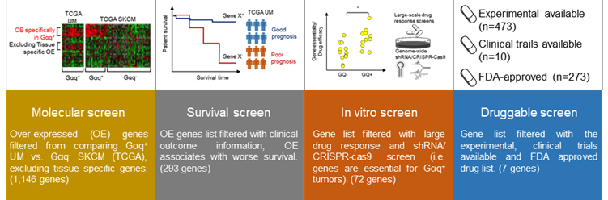
ISLE identifies synthetic lethal partners of Gq in UM

Slide 28
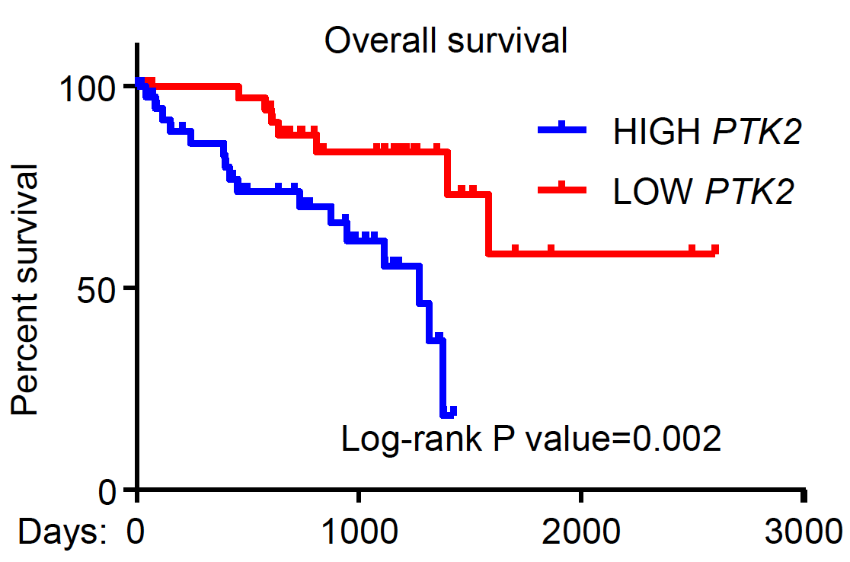
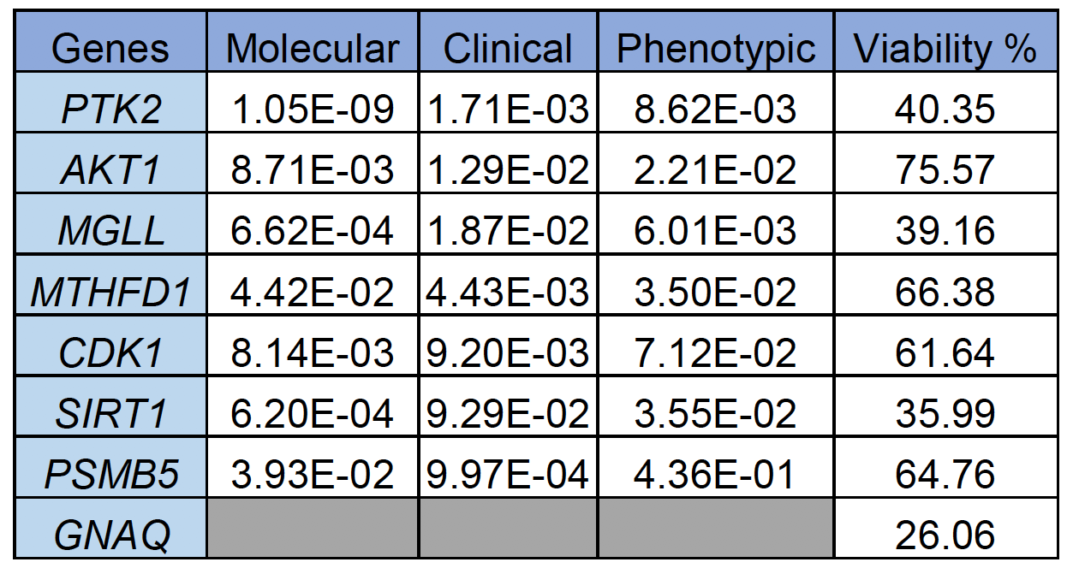
ISLE identifies PTK2 (encodes FAK) inhibitor as top hit
Top predicted vulnerabilities
Clinical relevance of PTK2 (FAK)

Slide 29
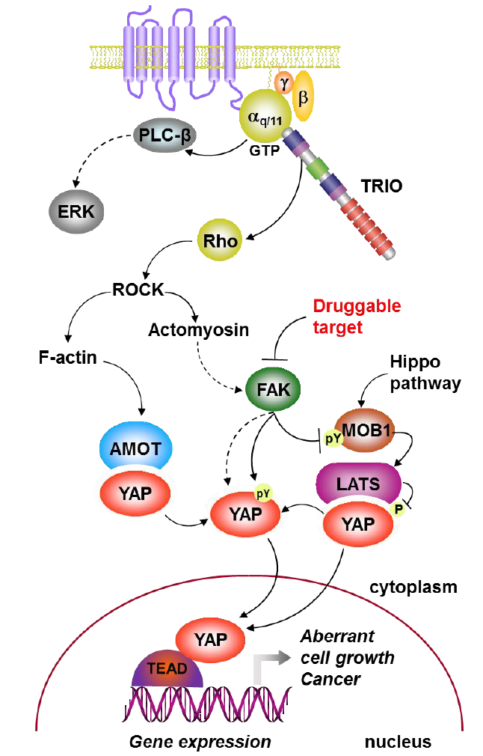
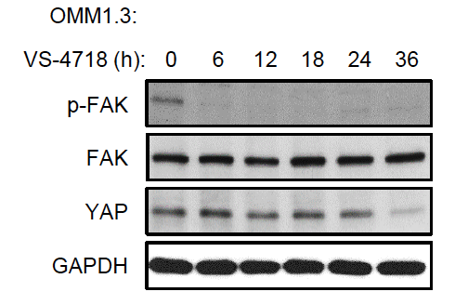
Gq activates YAP via FAK
Gq activates FAK by a non-canonical signaling pathway
In turn FAK activates YAP by a novel mechanism suppressing the Hippo kinase cascade.

Slide 30
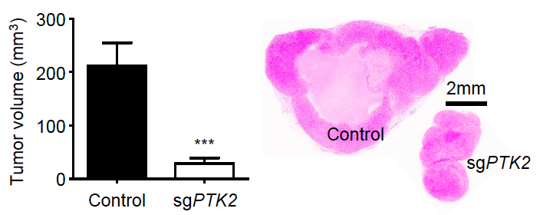
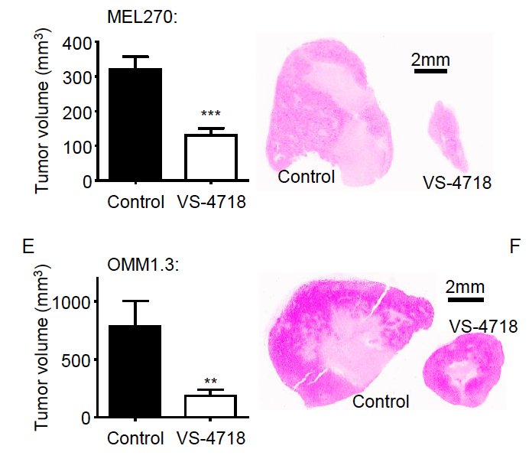
Mouse model supports FAK as therapeutic target
FAK as a viable precision therapeutic target for the treatment of uveal melanoma supported by in vivo experiments.

Slide 31
Drug repurposing of FAK inhibitor to UM
Ongoing clinical trials of FAK inhibitors
- Phase II trial of combination therapy Vismodegib and FAK inhibitor (GSK2256098) in basal cell carcinoma (NCT02523014)
- Phase I trial of combination therapy FAK inhibitor (GSK225609) and Trametinib (MEK inhibitor) in advanced solid tumors (NCT01938443)
- Phase I trial of combination therapy FAK inhibitor (Defactinib), Pembrolizumab (PD1 antibody) and Gemcitabine in solid tumors including pancreatic cancer (NCT02546531)
Our study indicates potential efficacy of FAK inhibitors in UM

Slide 32
Before moving to CDSL, I was doing some cancer projects and some quality control projects
https://github.com/aaschaffer/vecscreen_plus_taxonomy
We identified and corrected 11,355+ contaminated/flawed sequences in GenBank

Slide 33
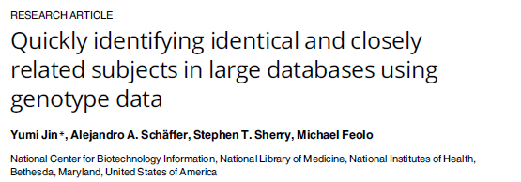
Volume 12, article e0179106
https://www.ncbi.nlm.nih.gov/projects/gap/cgi-bin/Software.cgi
We developed GRAF to identify quickly samples within and across dbGAP Genome-wide association data sets that come from the same individual or closely related individuals.
Premise: In case-control association analysis one should not use closely related individuals as if they were independent samples.

Slide 34
Take-home messages
NCI’s Cancer Data Science Lab exists and is growing, with many NCI collaborations started
Quality control of data (part of “data wrangling” or “data exploration”) is essential to good data science
Fundamental problems in cancer diagnosis and treatment can be constructively viewed as problems in data science; these include: How to harness synthetic lethality in cancer treatment? and Which patients will benefit from immunotherapy?
NCI/NIH has some of the qualities that allowed early data science to flourish at Bell Labs, but beware of restrictions on data access/publication

Slide 35
How did this high-risk project start?
We were working on a low-risk project for recognizing 16S RNA sequences, when Rich McVeigh noticed that:
Date: Wed, 16 Sep 2015 12:06:06 +0000
From: "McVeigh, Richard (NIH/NLM/NCBI) [C]" <mcveigh@ncbi.nlm.nih.gov>
David [Lipman] and Alejandro
I took the complete fasta set and ran them through the full set of tests we use in indexing for evaluating sequences
...
Note I found sixty six of the sequences contained a significant amount of vector contamination.
In all the yes cases, Alejandro's result agrees with mine....
Rich
I started to ask questions about the vector contamination…

Slide 36
Sources of Contamination
Sample Collection
DNA Extraction
Library Preparation
Submission to database
Sequencing
In vivo
In vitro
In silico
Infection with viruses, microbes or parasites
Contaminated reagents
Adaptors & primers
Spike-ins
Errors in tracking data or metadata
Aerosols
Cloning vectors
Spill-over
Symbionts
Cross-contamination of DNA
E. coli & phage
Carry-over
IS & Transposons
Commensals
Mitochondrial DNA
Errors in tracking of libraries
Food
Gut microbes
Human
handlers
Cross-contamination of samples
Errors in tracking of DNA preps
Errors in sample tracking
Paul Kitts
Errors in sample tracking

Slide 37
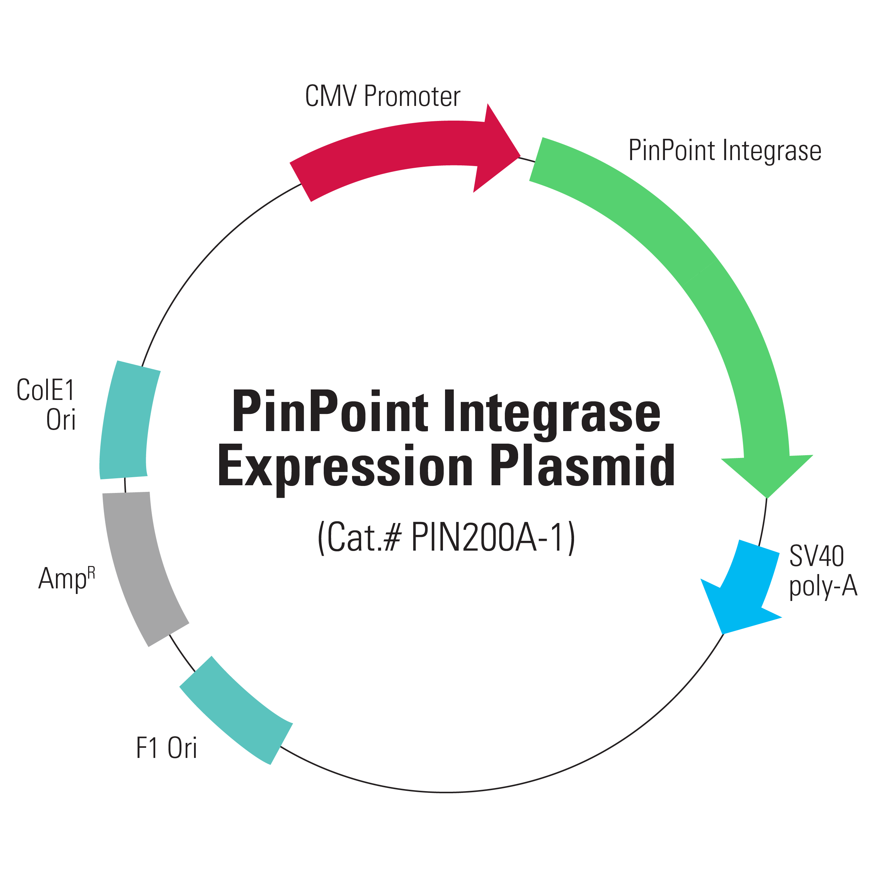
What Are Cloning Vectors and Contamination?
A cloning vector is a piece of DNA (usually circular) in which a DNA sequence can be copied in a natural organism (e.g., E. coli)
A vector V is usually an engineered juxtaposition mosaic of sequences, some of which are from real biological sources and some of which are artificial.
When a biologist prepares a cloned sequence S for submission to a database, the starting point is a circularized concatenation of V and S.
The biologist must remove (“trim”) V and keep S.
“Vector contamination” occurs when the biologist does not do the trimming correctly and the submitted sequence contains more than S.

Slide 38
What are UniVec and vecscreen?
UniVec is a collection of known vector sequences.
UniVec is currently in version 10, with 6093 sequences.
UniVec is curated by Paul Kitts.
The sources of UniVec are a mixture of natural and synthetic, but the sources were not documented.
vecscreen is conceptually blastn of potentially contaminated queries vs. UniVec as a BLAST db, with distinctions for the region of the query in which the blastn match occurs (match at an end is more likely contamination) and an idiosyncratic output content+format

Slide 39
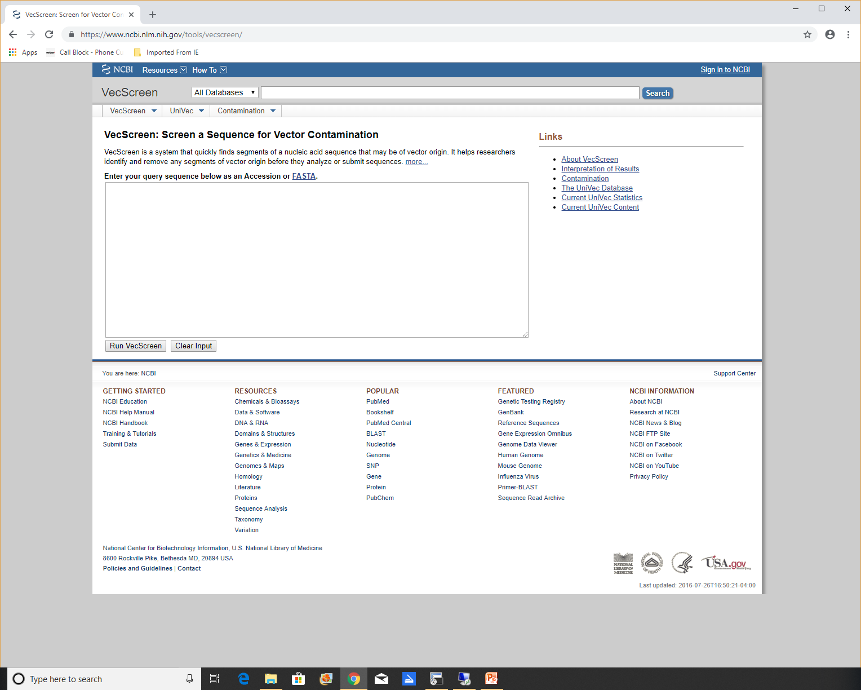

Slide 40
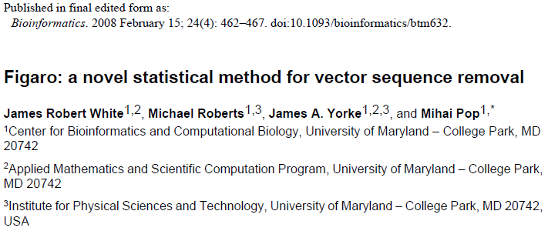
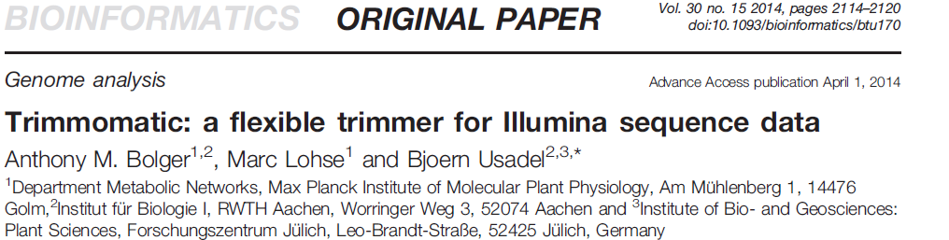
Examples of Competitors to VecScreen for NGS Data
Figaro assumes uses a statistical model, so it requires a large homogeneous data set, but not the vectors. Assumes only terminal matches.

Slide 41
What Problem(s) Are We Trying to Solve?
Stated Problem: Given vecscreen outputs, which are true positives (contamination) and which are false positives?
Turns out not to be the right problem…
Initial approach: Expert systems; ask the experts (Rich McVeigh, Ilene Karsch-Mizrachi) how they solve the problem and implement their solution in software.
Caveat: Two experts allows for inter-expert discordance.
NCBI constraint: Solution must use UniVec/vecscreen
NCBI preference: in NCBI sequence analysis, BLAST is a hammer and every problem looks like a nail.

Slide 42
If we find a contaminated sequence in the GenBank part of nr, Rich McVeigh can correct it. “Correct the sequence” could mean any of:
Trim the vector segment
Contact the submitter to confirm appropriate action
Correct taxonomy to identify the sequence as synthetic
Correct annotation
Unverify the sequence
Suppress the sequence
Prospective analysis uses 2, while retrospective analysis uses 1, 3, 4, 5, 6
Rich McVeigh

Slide 43
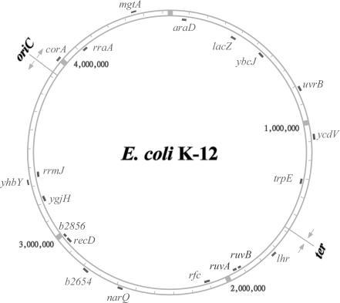
A sequence and a vector can overlap if they originate from the same genome (genus level)
For example, most of the UniVec entry U13860.1:1494-2319 is an unambiguous perfect match to
NC_007779: positions 256055-256832.
If an nr sequence whose genus is Escherichia overlaps [256055-256832] , it will have a VecScreen match to U13860, but that match should be considered FALSE_BIOLOGICAL (not vector contamination).
Call this the “in genome” test.
Beware of circular reasoning about sequence origins (all meanings intended)!

Slide 44
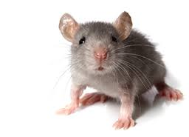
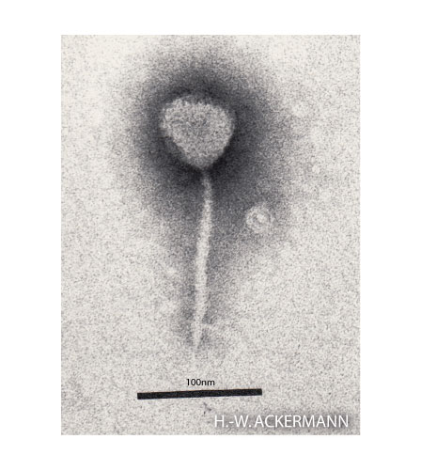
“Out of genome” test with positive evidence
Suppose sequence S matches a vector segment V,
we know the taxonomy of S and V, and
S and V differ above the level at which the “in genome” test is applied for V,
then, the (S,V) match is a true positive (actual vector) or random.
Special case: If V is artificial, then all matches to V are true positive or random
Example: AF121976.2 (of genus Mus, 10088) has a strong match to segments of uv|U02426.1:19740-19836 and uv|U02426.1:19992-20125, which come from a phage (genus Lambdalikevirus, 186765).
S
V

Slide 45
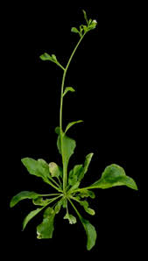

“Out of genome” test with negative evidence
Suppose sequence S matches vector segment V,
we know that S comes from genus G, and
we know that V does not come from genus G, because we previously identified all vectors coming from genus G, or because we know V is artificial
then the (S, V) match is a true positive or random.
In summer 2018 test8 run, 151/2884 (5%) of Strong, Moderate matches classified as NO_DATA
S
V
BT004235.1
uv|AF310136.1:224-2163

Slide 46
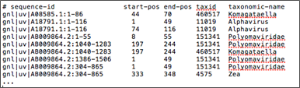
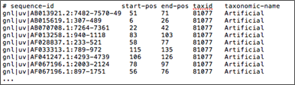
What Problem Did We Need to Solve to Apply the “in genome” and “out of genome” tests?
Answer: Find the taxonomic source of as many intervals of UniVec sequences as possible
Current counts:
489 UniVec entries entirely artificial
559 other entries have an artificial interval
3594 entries have at least one interval assigned to a biological source
4429/6093 (73%) UniVec entries now have some source information (one before current version is on UniVec ftp site)
In summer 2018 run, 1428 sequences had at least one match classified as TRUE_ARTIFICIAL; all(?) true positive.

Slide 47
Current Classifications of VecScreen Matches
FALSE_AMR (special case of FALSE_BIOLOGICAL, for bacteria)
FALSE_BIOLOGICAL
LIKELY_FALSE_BACTERIAL (for unclassified bacteria)
NO_DATA (check every match to find new sources)
TRUE_ARTIFICIAL
TRUE_ARTIFICIAL_MICROSAT
TRUE_BIOLOGICAL (check every match to find new data/rules)
TRUE_MICROSAT

Slide 48
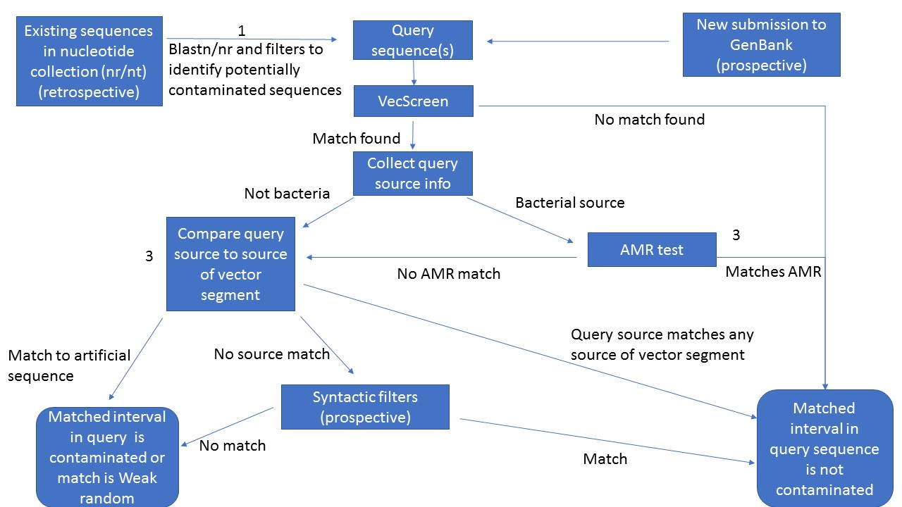

Slide 49
Possible benefits of retrospective decontamination of nr
Reduce potential embarrassment, especially for RefSeqs
Reduce misleading BLAST matches and messages to ncbi-help
Competitive advantage for NCBI over EMBL and DDBJ (Rich and Ilene are empowered to correct only GenBank sequences)
Clean government → clean data
Clean genomic data → better patient care (S. L. Salzberg et al. Neurol. Neuroimmunol. Neuroinflam 2016: 3:e251 )
Counts as of September 4, 2018: 11,355 sequences corrected, including 310 RefSeqs; another 1500+ non-RefSeqs on Rich’s queue.

Slide 50
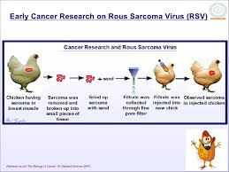
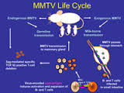
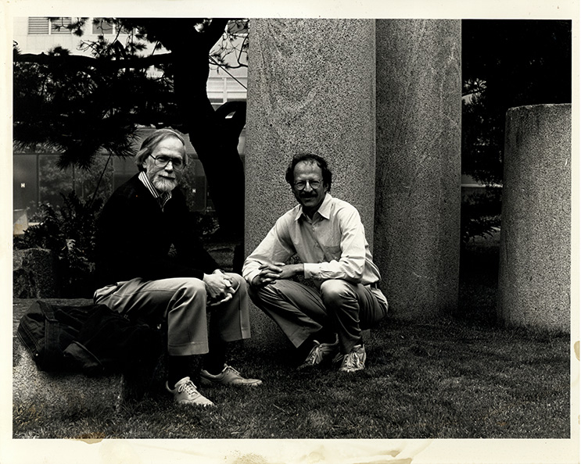
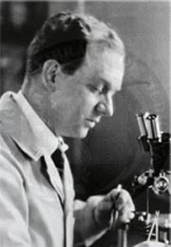
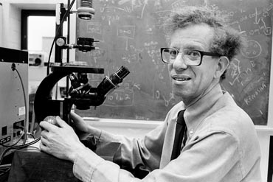
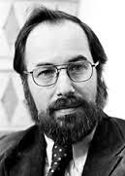
A Connection to Cancer:Retroviruses Complicate “In Genome” Inferences
J. M. Bishop (1936-)
H. E. Varmus (1939-)
F. P. Rous (1879-1970)
D. Baltimore (1938-)
H. Temin (1934-1994)

Slide 51
Aspects of the Retrovirus Problem In VecScreen_plus_taxonomy
Retroviruses are common in vectors because a common usage of vectors is to create recombinant DNA with foreign genes inserted
We allow a vector segment to belong simultaneously to virus taxid and a host taxid (Example: segments of Z22761.1:1-5585 belong to both 153135 Gammaretrovirus and 10088 Mus, but interval boundaries uncertain)
By standing on the shoulders of giants, we can encode the host specificity, even if we do not understand its biological basis
Ideally, we want to recognize the two-organism sequences and move them to the “synthetic” division of GenBank
In sum, the sub-problem of classifying matches in which the vector contains a retrovirus segment is mostly solved, but isolated issues with conservation, interval boundaries, and missing synthetic sequences remain.

Slide 52

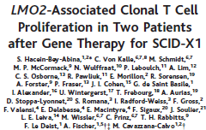
Integration Sites of Retroviruses to the Human Genome Are Not Random and Can Lead to Cancer

Slide 53
Snapshot from late July to get some upper bounds, part 1 of 6
Use srcchk to find lowest taxon of each sequence; exclude 11* species, e.g., taxon 10633, SV40, and PDB acc.
blastn of 5456 UniVec sequences vs. nr in late July 2016
Apply 63 syntactic filters such as
NOT "src transgenic" [PROP]
136450 seqs.
60704
* A shortcut to revisit
57653
Remove sequences of length > 7000nt, to avoid complete genomes and sequences with mixed outcomes*
Run vecscreen on sequences surviving to this step
Retrieve deflines;
Filter out sequence with text match to 3 terms
46263
57556

Slide 54
Medium-Term Goals
Retrospective identification of all (perhaps, only Strong, Moderate) matches in nr (for length ≤ 7000nt)
Develop methods and software to classify vecscreen matches as TRUE, FALSE, QUESTIONABLE , …
Correct as many true positive matches as possible
Document everything
Write a manuscript
(Maybe?) Identify genomic sources of some UniVec sequences

Slide 55
Big run snapshot, the main step of the “in genome” test, part 6 of 6
vecscreen match is in some genus G of interest?
UniVec interval overlaps intervals for G?
yes
yes
The vescreen match is considered “in genome” and treated as not vector
no
no
Keep classification unchanged
Keep classification unchanged
Reminder: The programs evaluate per match, not per sequence, but Rich’s evaluation is per sequence.

Slide 56
Big run snapshot, part 2 (parse vecscreen results, separate sources) of 6
Run vecscreen on sequences that survive to this point (vescreen requires a higher score for internal than initial blastn step)
Parse vecscreen output to obtain a tab-delimited text format, for Rich and Ilene
23585
Is source gb? If so, separate terminal/internal matches
Prepare EMBL (6887 seqs.) and DDBJ (3200 seqs.) vecscreen match summaries for Rich
Do further analysis on gb matching sequences (13498)
yes
no

Slide 57
Big run snapshot, “in genome” test, part 5 of 6
12672 seqs passing filters through previous flowchart
Are all sequence intervals in seq and UniVec match in the same genus?
864 seqs not requiring further actions
yes
no
11808 sequences requiring attention*
*See /panfs/pan1.be-md.ncbi.nlm.nih.gov/dnaorg/2015.09/vector_screening/test7b/summary_noamr_nogenome_20160801.txt
Among the 11808 sequences, 3391 have all segments predicted as FALSE, leaving 8417 seqs.
After taking this snapshot, we began a targeted effort to classify the 11808 sequences and the matching segments.

Slide 58
Snapshot, Anti-microbial resistance factors test, part 3 of 6
13498 sequences* under consideration from previous slide
826 seqs not requiring further actions
Are all matching segments AMR?
yes
no
Predict whether each segment is TRUE (vector) or FALSE (not vector) contamination
12672 seqs for additional analysis, not limited to prediction
*13498 sequence accessions with predictions for each segment can be found at:
/panfs/pan1.be-md.ncbi.nlm.nih.gov/dnaorg/2015.09/vector_screening/test7b/summary_genome_exclusions_20160801.txt

Slide 59
One time (?) pre-computation to set up for “in genome” tests of every vecscreen match; big run snapshot, preparing for part 6 of 6
Identified 13 genera# suspected/known to be sources for UniVec
Retrieved* genomes from BLAST Reference Genomes
Find gapless 100% identity alignments between genomes and UniVec segments
Examples of excluded intervals:
4930 uv|U03441.1:2303-2465 52 85
561 uv|U12640.1:3763-3875 65 113
286 uv|Z50120.1:1-230 18 48
Remove UniVec segments that are not genus-specific^
4930: Saccharomyces; 561: Escherichia; 286: Pseudomonas
*Some specific genomes from the same genus were added to correct results.
^Genus-specifc depends on which genera are included.
# Only 6 of the genera were used in the large-scale analysis; 7 genera added later.

Slide 60
We are implementing methods (work in progress) to predict true positives (vector) vs. false positives (not vector) using:
blastn matches to the sequence and their coverage of the putative vector region
deflines of blastn matches to putative contaminated sequence (e.g., does the sequence match vectors)
taxonomy (e.g., matches in many genera suggests true positive)
percentage identity of matches
whether the possibly contaminated sequence is part of a batch submission of similar sequences that are blastn matches for each other
etc.

